Slide 1
Alvaro Raul Martin Peraza
[DATE]

Slide 2
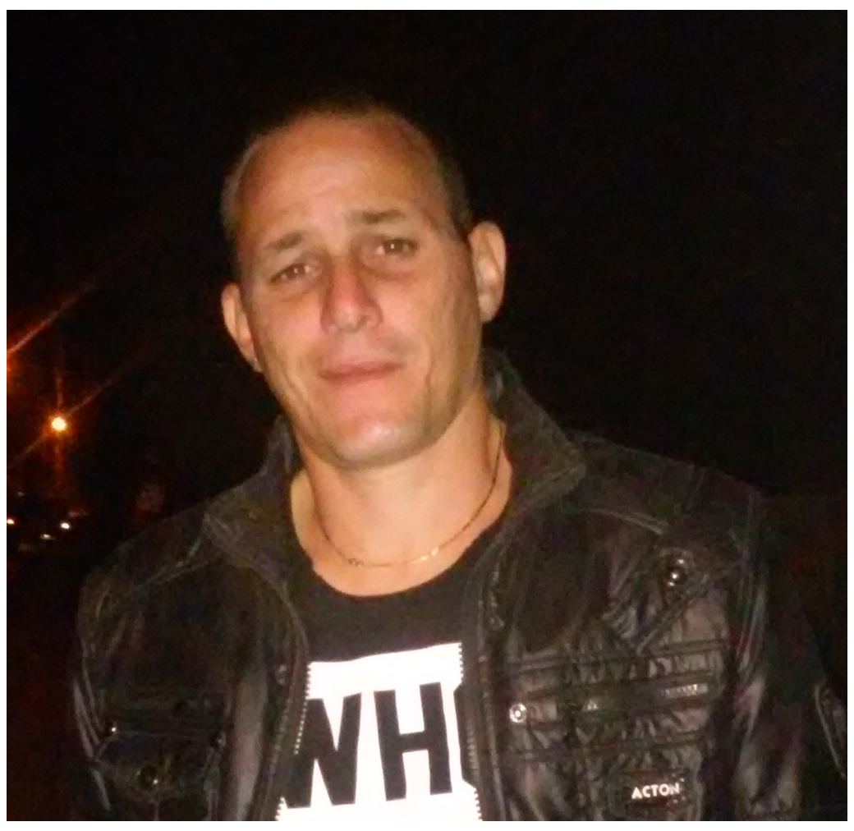
Alvaro Raul Martin Peraza
Curriculum Vitae | 12/06/2021
Alvaro R Martin
CONTACTS
Mtr. Software's Develop
exagonsoft@gmail.com
+53 53669086, +5356839233
Encrucijada, Villa Clara, Cuba
If you can’t explain in a simple way, then you don’t understand ‘it at all.
PROFILE
PROFILE SUMMARY
From restless nature , I define myself as an addict of knowledge , reliable and engaged with my work and admirer of the human potential. I like to practice sports , to read and the Japanese Anime’s. I have two passions in my life: My children and software's develop.
EMPLOYMENT STATUS:
Self employed
WORKING EXPERIENCE
17 years
EDUCATION
TECHNICAL SKILLS
Mtr Software's develop
PROGRAMMING LANGUAGES
C#, JavaScript, PHP, Visual Basic .NET, Solidity, Xamarin, Unity, Java, HTML 5, CSS.
LANGUAGES
Spanish: Native
FRAMEWORKS & LIBRARIES
ASP .NET, Core .NET, React, Angular JS, Vue JS, Laravel, Bootstrap, Node JS.
English: level 6
MOBILE TECHS
Android / IO full stack Develop
SOCIAL
DESKTOP TECHS
Full Stack Windows Base Apps
DATABASES
MySQL, SQL, SQL Server, PostGreSQL
Alvaro Raul Martin Peraza
METHODOLOGIES
Version Control, TDD, log management
ExagonSoft
ORM
[enter your orm tech skills]
ExagonSoft
Visual Studio .NET, Visual Studio Code, Android Studio, Eclipse.
ExagonSoft]
BUILD TOOLS
CONTINUOUS
INTEGRATION
Github
OTHERS TOOLS
Self developed Universal Code Generator
2

Slide 3
Alvaro Raul Martin Peraza]
Curriculum Vitae | 12/06/2021
WORKING EXPERIENCE
2013-Today
Exagon-Soft, personal project
Projects:
Heroes of AltherA : Roll-Play Game, with play to earn reward system, running over Binance Chain.
Team: 5 | Developer chief
Main Technologies: Unity, Blok Chain.
Zorking Token : Smart contract to support the Heroes of AltherA economic ecosystem.
Team: 3 | Coordinator, Developer Chief
Main Technologies: Solidity, Block Chain.
2012
MovilMundo
Projects:
Dr. Phone : Simulation Game for Android
Team: 1 | full stack developer
Main Technologies: Java
2009-2011
Soft Logic
Projects:
Gulfstream Academy Scheduler : Online Scheduler for Gulfstream academy
Team: 4| developer
Main Technologies: ASP.NET, Web App
2006-2009
Affilianet
Projects:
Email-Marketing : Automatic mail span deliver
Team: 12 | developer
Main Technologies: ASP.NET, Web App
Affiliate NET : Business platform for the electronic publish campaigns launch
Team: 45 | developer
Main Technologies: ASP.NET, Web App
3

Slide 4
Alvaro Raul Martin Peraza
Curriculum Vitae | 12/06/2021
EDUCATION
2000 -2005
CUJAE, Informatics' Engineer
Knowledges:
Systems and Methods
Mathematical Analysis I
Digital Systems I
Introduction to Programming
Law Applied to Computer Science
Algebra
Mathematical Analysis II
Computer Architecture
Database Data
Structure and Algorithms
Introduction to Software
Engineering Introduction to Communications
Operating Systems Laboratory I
Systems Analysis Probability and Statistics Applied
Computing Laboratory II
Linear Algebra
Systems Design
Physics I
Laboratory IV
Laboratory III
Systems Audit
Mathematical Analysis III
Physics II
Systems of Physical Representation II
Administration of Projects
Formal Languages and Finite Automata
Laboratory V
Numerical Calculation 2
Analysis of Information and Decision
Strategic Planning Research
Project I
Network Security
Fundamentals of Economics and Finance
Artificial Intelligence
Supervised Professional
Information Theory M
Models and Simulation
2006-2008
CUJAE, Mtr Software's Develop
Knowledges:
Software Process Quality
Formal Methods
Database 1
Database 2
Distributed Systems
Personal and Team
Software Development
Advanced Topics in Software Engineering
Software Process Quality
Software Quality
Learning Cognition
4

